Slide 1

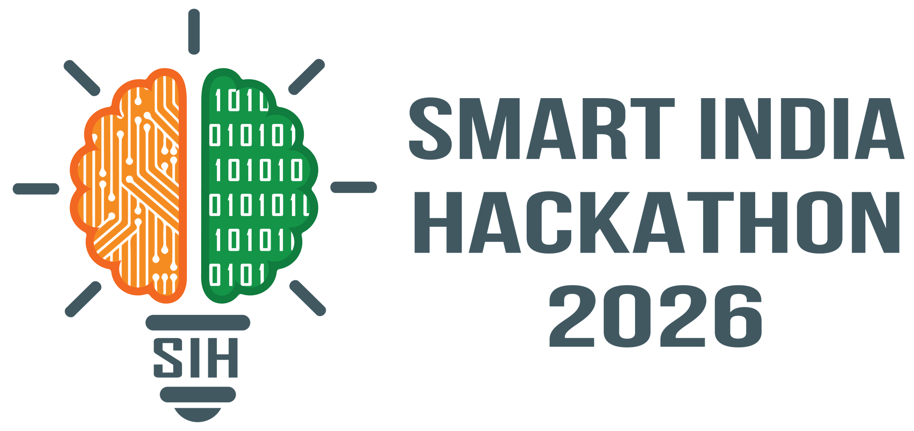
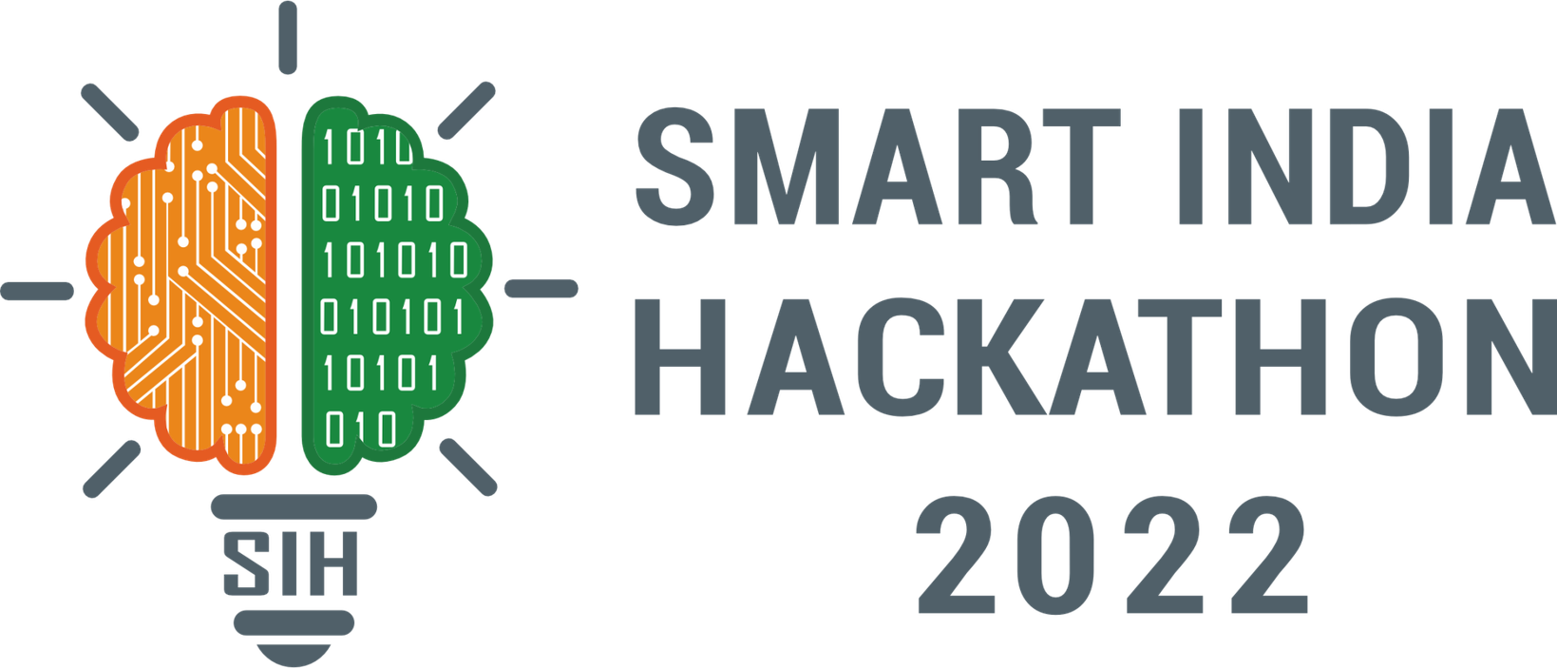
SMART INDIA HACKATHON 2026
  Problem Statement ID: SIH26057
  Problem Statement Title: AI-Powered Automated Underwater Marine Debris and Anomaly Detection System using Side-Scan Sonar Imagery
  Theme: Disaster Management
  PS Category: Software
  Team ID: 141772
  Team Name: Deep Horizon

Slide 2
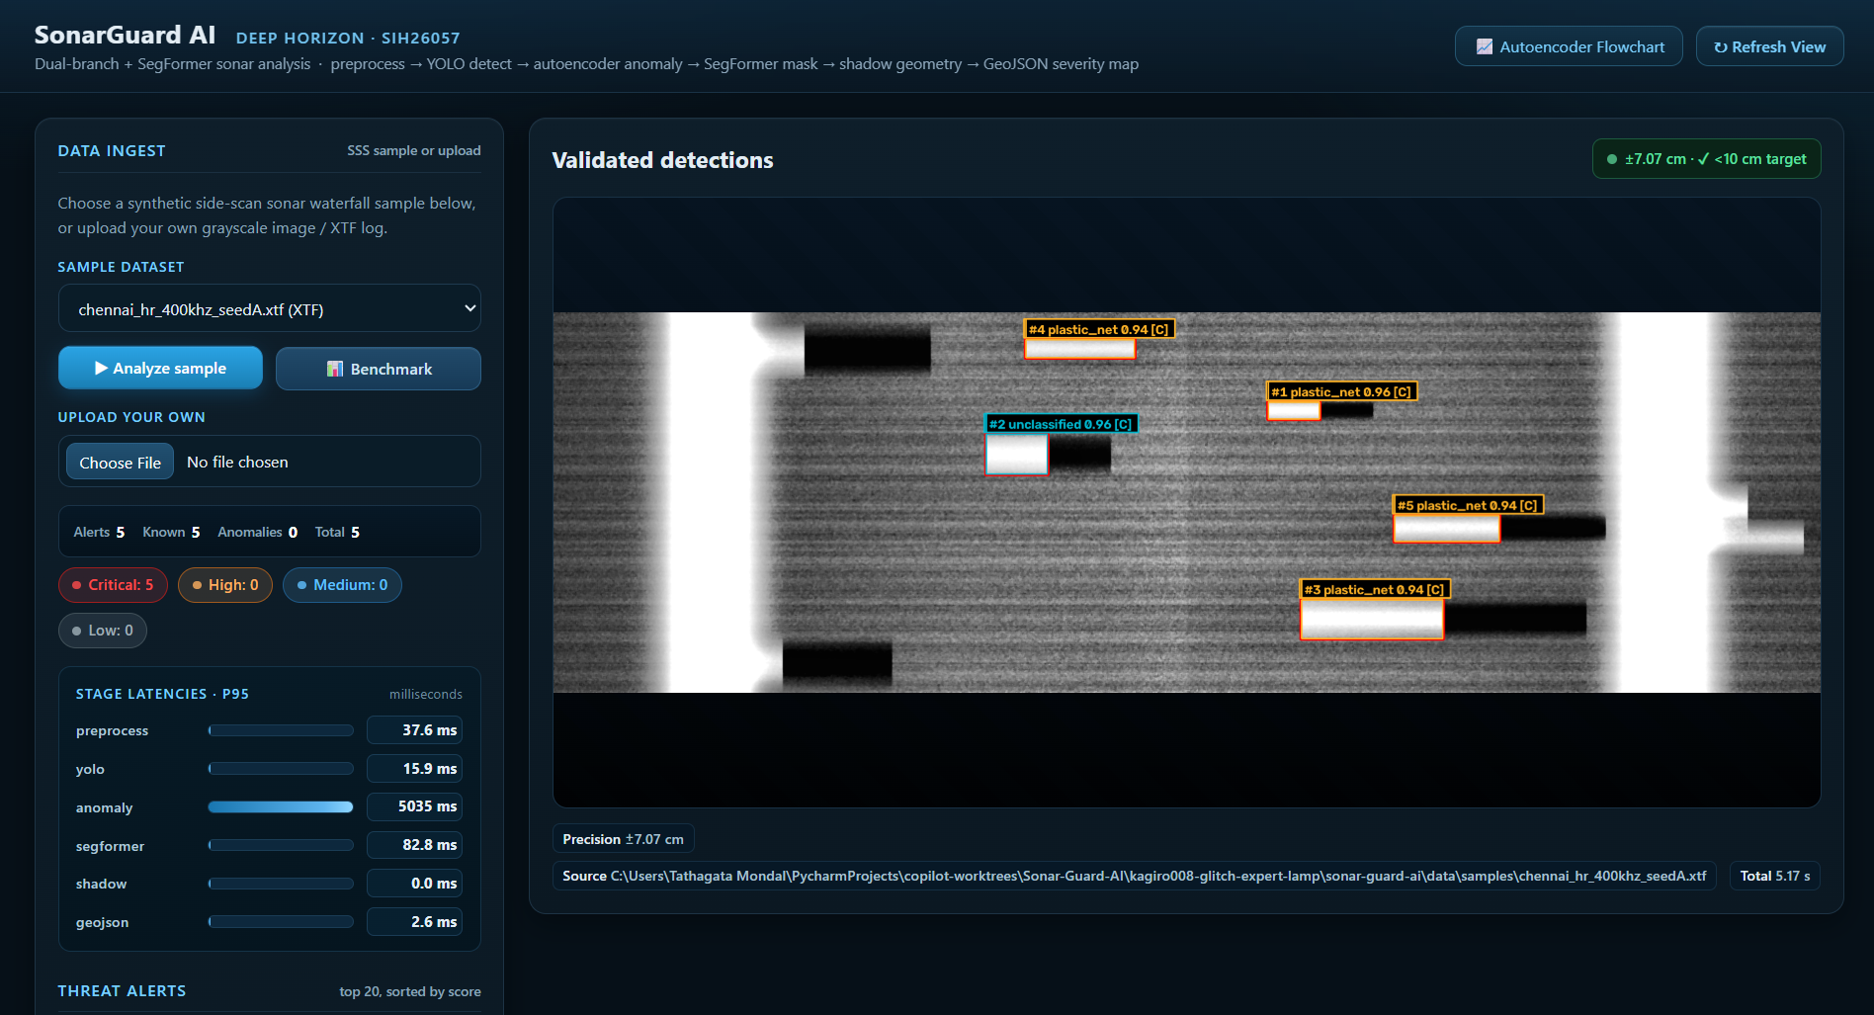
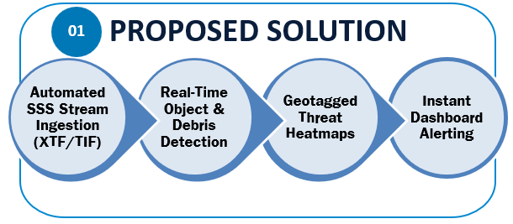
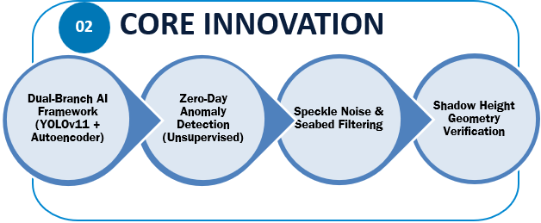
IDEA TITLE
Deep Horizon
PROPOSED SOLUTION & INNOVATION OVERVIEW
Sonar Guard AI — Automated Sonar Analysis Engine
Sonar Guard AI — Prototype
Real-Time
Processing Speed
Dual-Branch
YOLOv11 + Autoencoder
< 10cm
Geotag Precision
02
Notes:
2

Slide 3
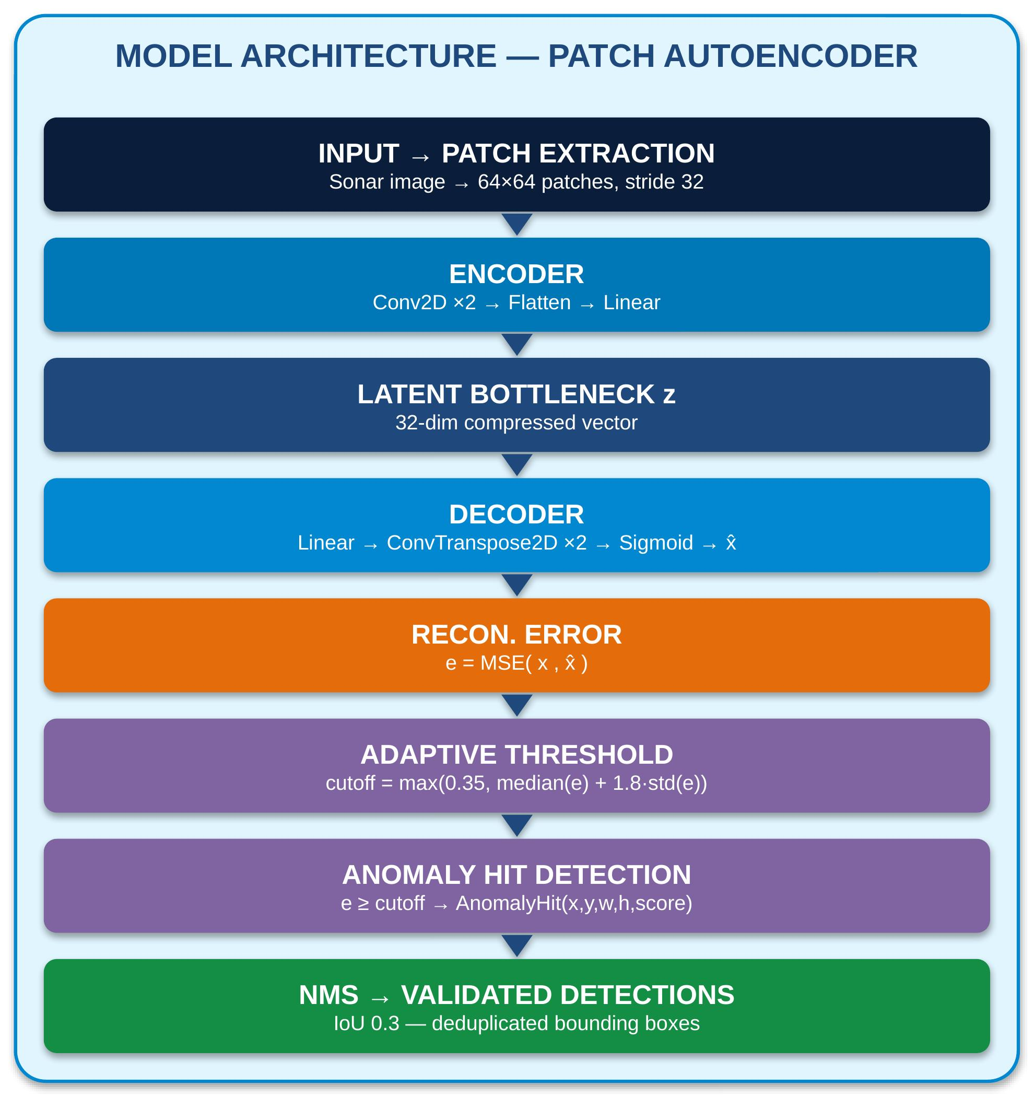
TECHNICAL APPROACH
Deep Horizon
END-TO-END TECHNICAL FLOWCHART & METHODOLOGY
2. Preprocess
CLAHE & TVG speckle filtering
3. Dual AI
YOLOv11 + Autoencoder execution
4. Validation
Shadow height geometry check
5. Output
Geo JSON to operator dashboard
1. Ingestion
Sonar XTF logs & GPS positioning
CORE TECH STACK: Python, PyTorch, OpenCV, CUDA | YOLOv11, SegFormer, Autoencoders | XTF/TIF Parsers, FastAPI, TensorRT on NVIDIA Jetson
03
Notes:
3

Slide 4
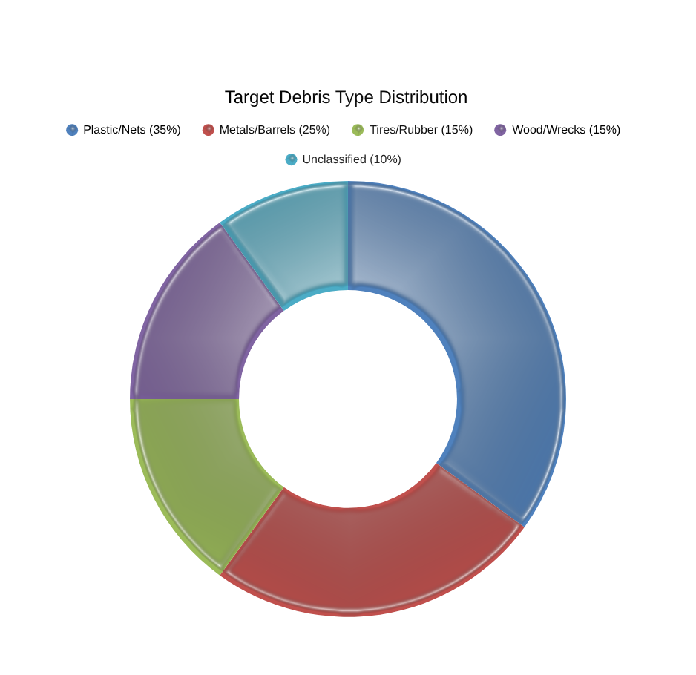
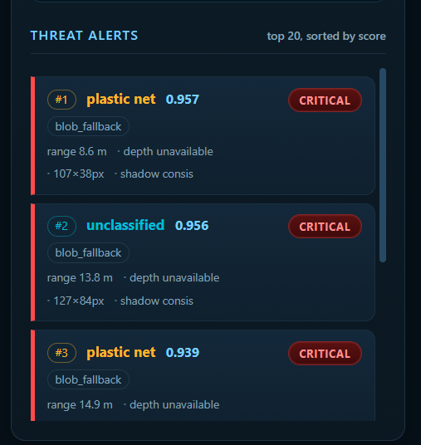
FEASIBILITY AND VIABILITY
Deep Horizon
FEASIBILITY PIPELINE & DEBRIS CATEGORIZATION
TECHNICAL FEASIBILITY
• Rapid transfer learning using pre-trained vision backbones.
• TensorRT edge optimization for lightweight deployment.
POTENTIAL CHALLENGES
• Limited availability of labeled side-scan sonar datasets.
• High speckle noise and rock false alarms.
MITIGATION STRATEGIES
• Synthetic data via StyleGAN & Blender rendering.
• CLAHE speckle filtering + shadow geometry validation.
04
Notes:
4

Slide 5
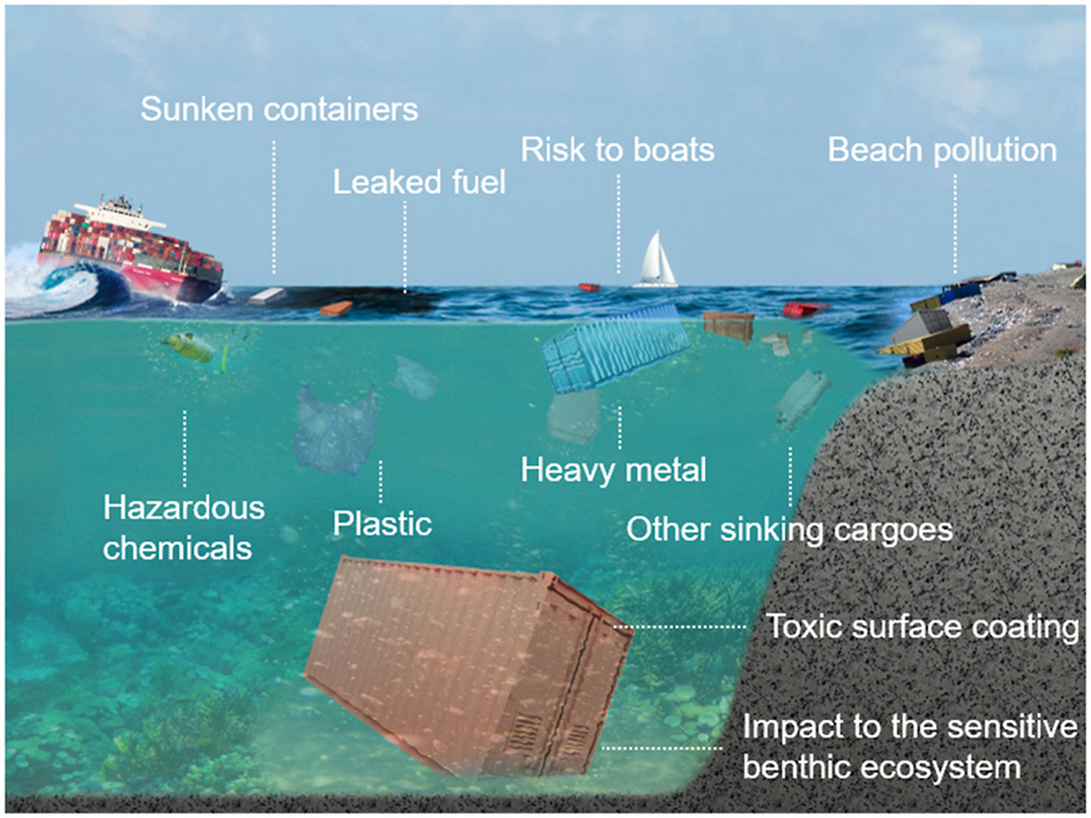
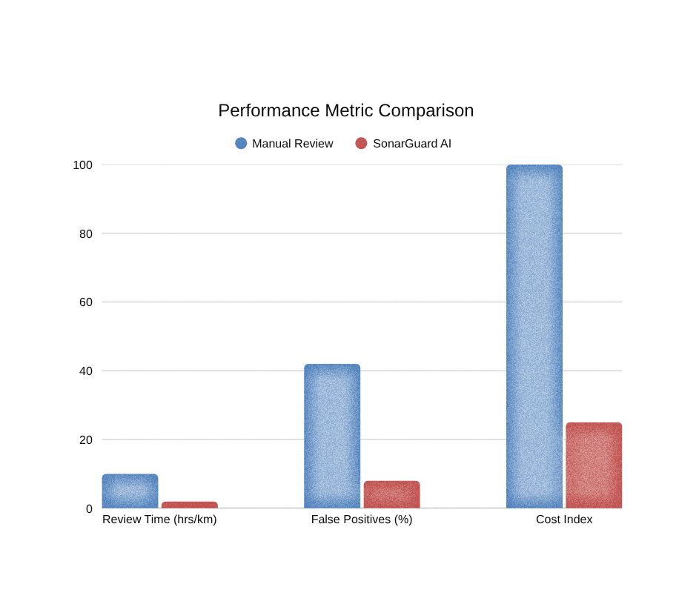
IMPACT AND BENEFITS
Deep Horizon
MULTI-DIMENSIONAL IMPACT & SYSTEM BENCHMARKS
SOCIAL IMPACT
Protects coastal vessels & reduces diver hazards.
ECONOMIC IMPACT
Cuts log review time by 80% & lowers dive costs.
ENVIRONMENTAL IMPACT
Accelerates removal of ghost nets & toxic plastics.
05
Notes:
5

Slide 6
RESEARCH AND REFERENCES
Deep Horizon
RESEARCH INSIGHTS & LITERATURE REFERENCES
INSIGHT 1: ACOUSTIC BACKSCATTER
Side-scan sonar imagery relies on acoustic backscatter, requiring specialized preprocessing to avoid false positives in standard vision models.
INSIGHT 2: DUAL-BRANCH RELIABILITY
Combining supervised detection with an open-set unsupervised anomaly network provides optimal reliability for submerged hazard detection.
Ref 1: SIH 2026 PS
ID SIH26057 - Ministry of Earth Sciences
Ref 2: Sethuraman (2024)
Shipwreck Segmentation from SSS,arXiv:2401.14546
Ref 3: Valdenegro (2025)
Marine Debris Forward & Side-Scan Sonar Datasets
Ref 4: Duras et al. (2024)
Underwater Marine Debris in Shallow Waters, SciData
06
Notes:
6

